Slide 1

CAT-III
BEE01T1005
Introduction to Digital System
Prepared by:
AVIRAL GAURAV 21SCSE1300029
ABHINAV KR CHAUDHARY 21SCSE1011615
DEEPANSH BHATIA 21SCSE1011677
NEERAJ SINGH 21SCSE1011675
ASHUTOSH RAI 21SCES1011691
Semester: II Section:24
Session 2021-2022

Slide 2
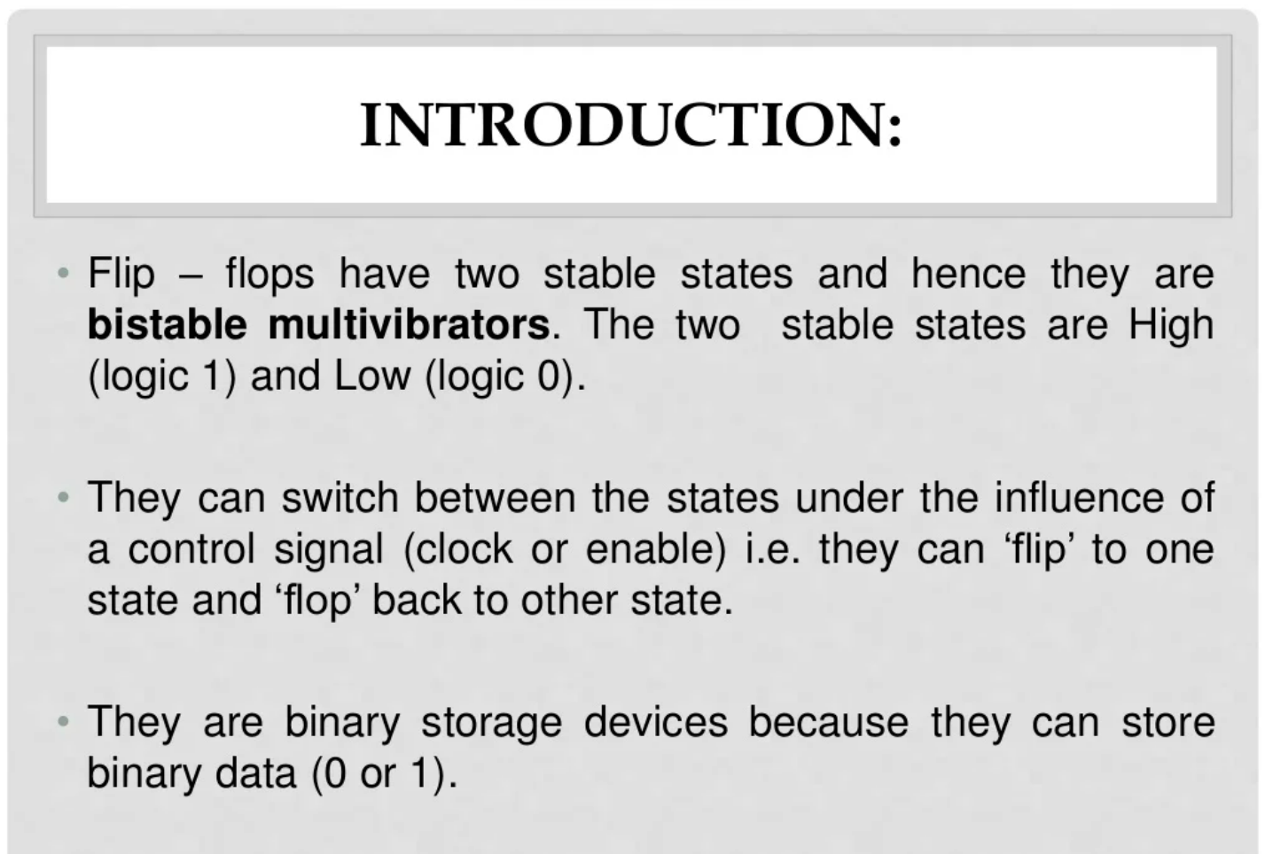
School of Computing Science & Engineering
Course Code : BEE01T1005 Course Name: Introduction to Digital System

Slide 3
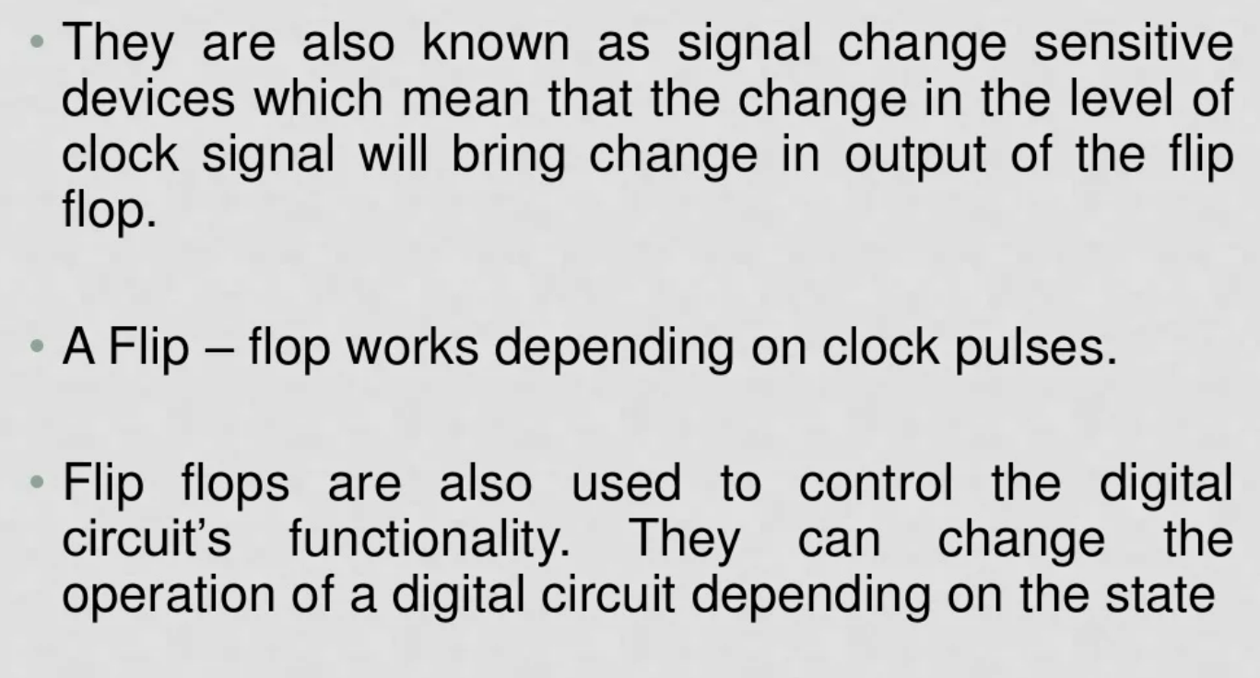
School of Computing Science & Engineering
Course Code : BEE01T1005 Course Name: Introduction to Digital System

Slide 4
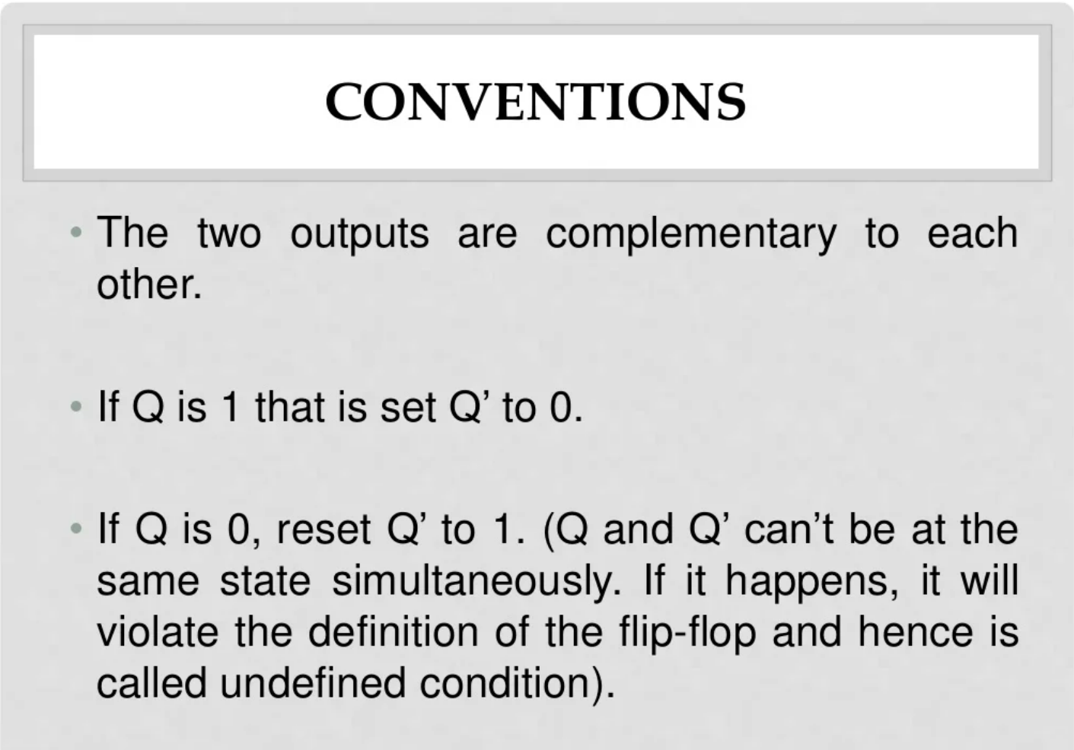
School of Computing Science & Engineering
Course Code : BEE01T1005 Course Name: Introduction to Digital System

Slide 5
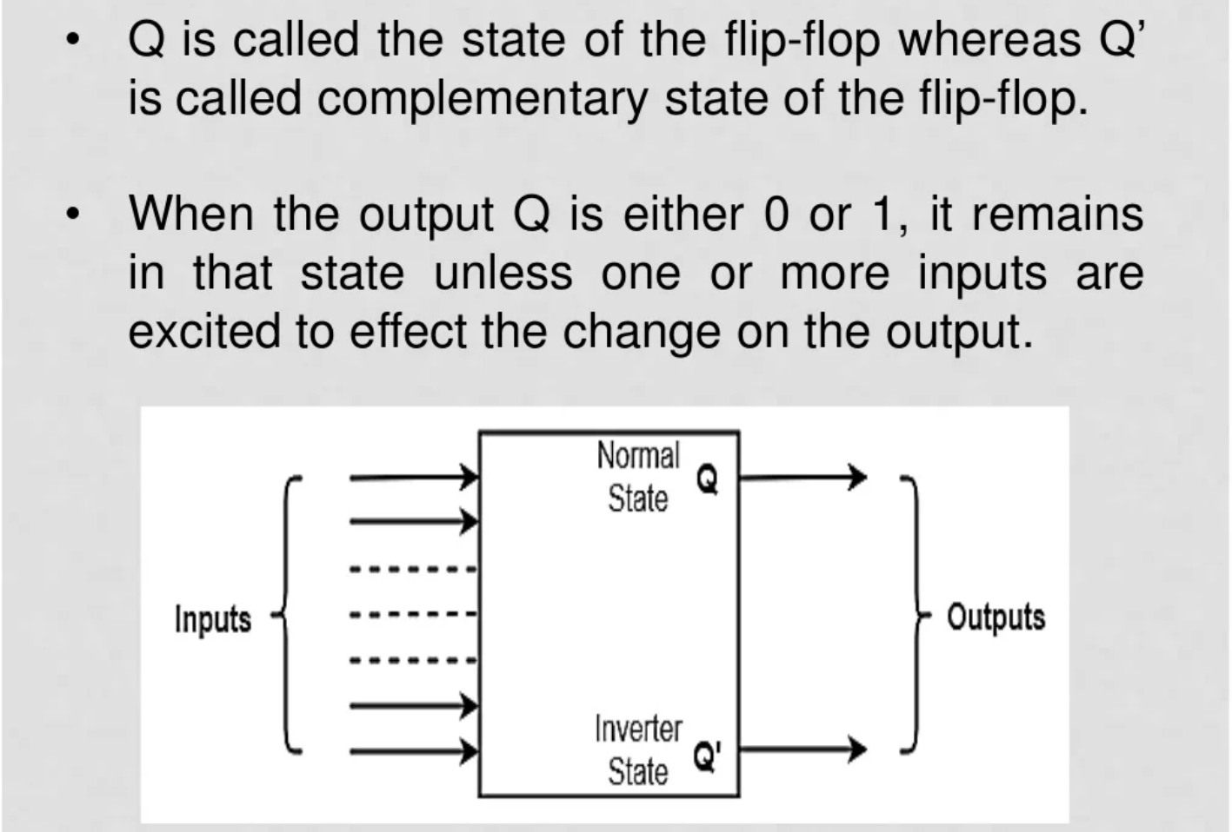
School of Computing Science & Engineering
Course Code : BEE01T1005 Course Name: Introduction to Digital System

Slide 6
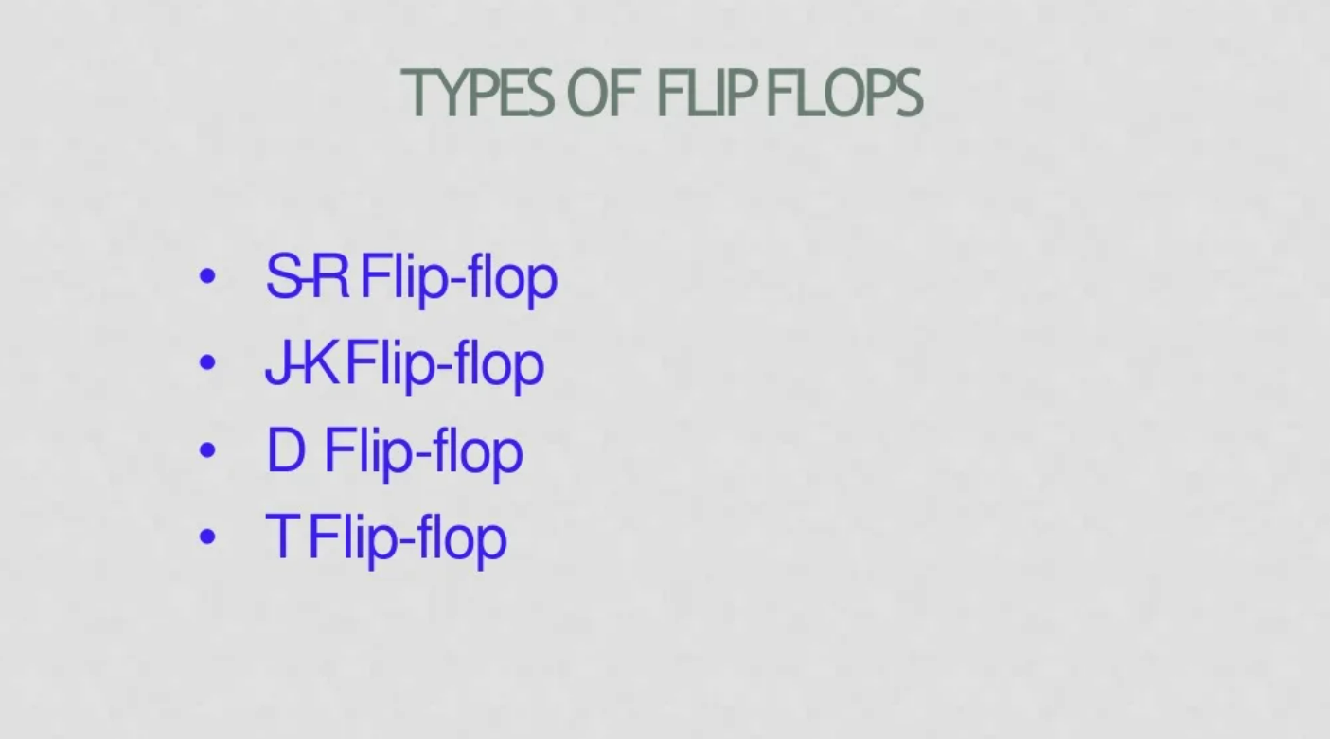
School of Computing Science & Engineering
Course Code : BEE01T1005 Course Name: Introduction to Digital System

Slide 7
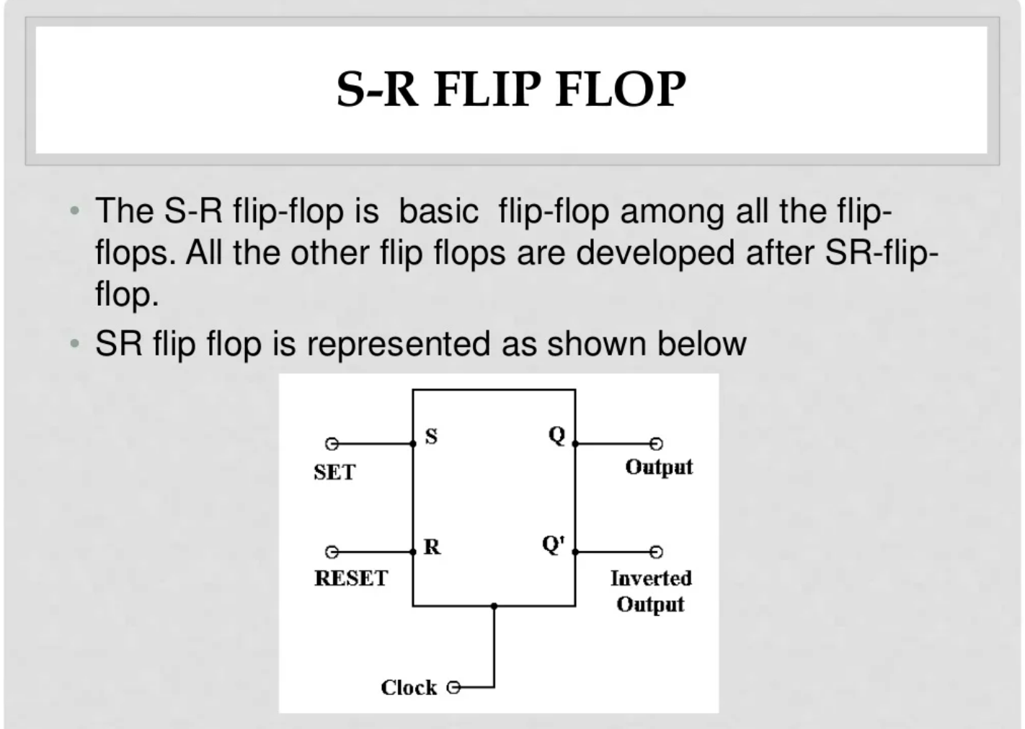
School of Computing Science & Engineering
Course Code : BEE01T1005 Course Name: Introduction to Digital System

Slide 8
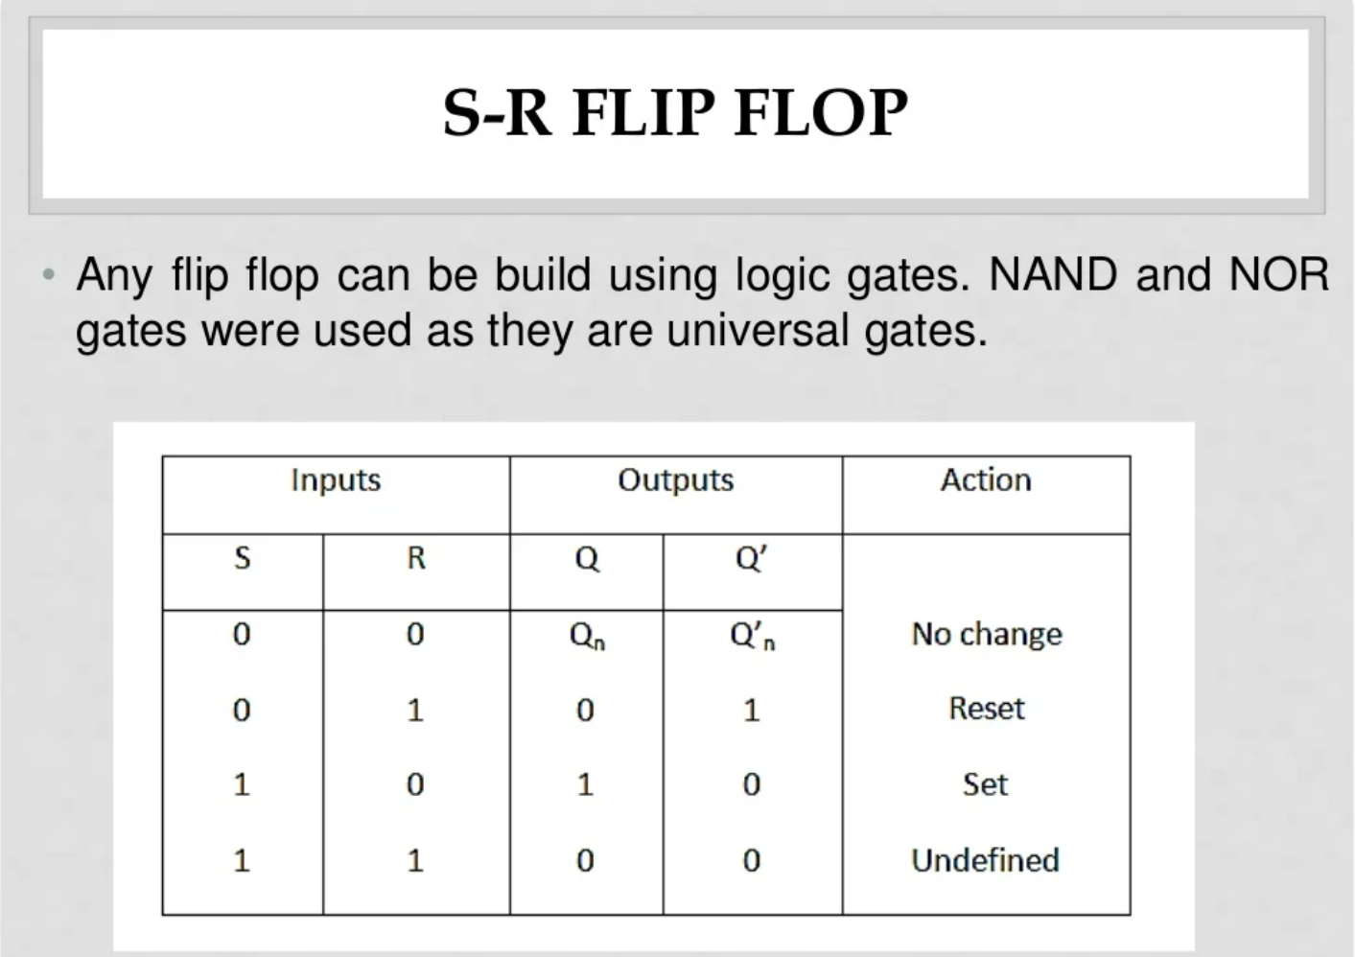
School of Computing Science & Engineering
Course Code : BEE01T1005 Course Name: Introduction to Digital System

Slide 9
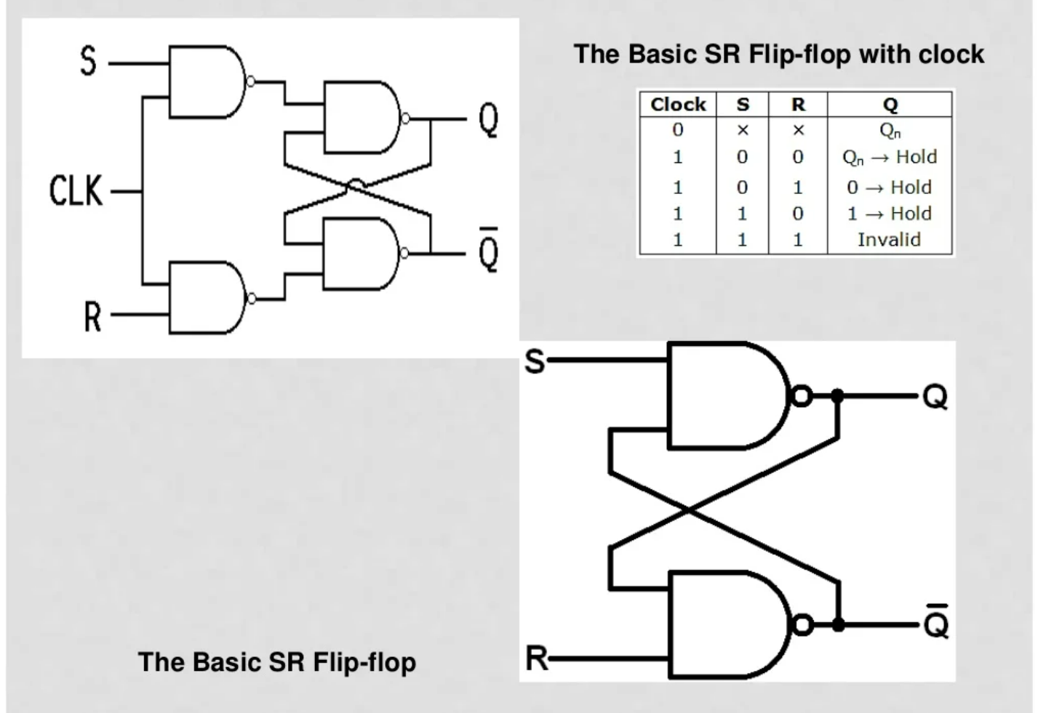
School of Computing Science & Engineering
Course Code : BEE01T1005 Course Name: Introduction to Digital System

Slide 10
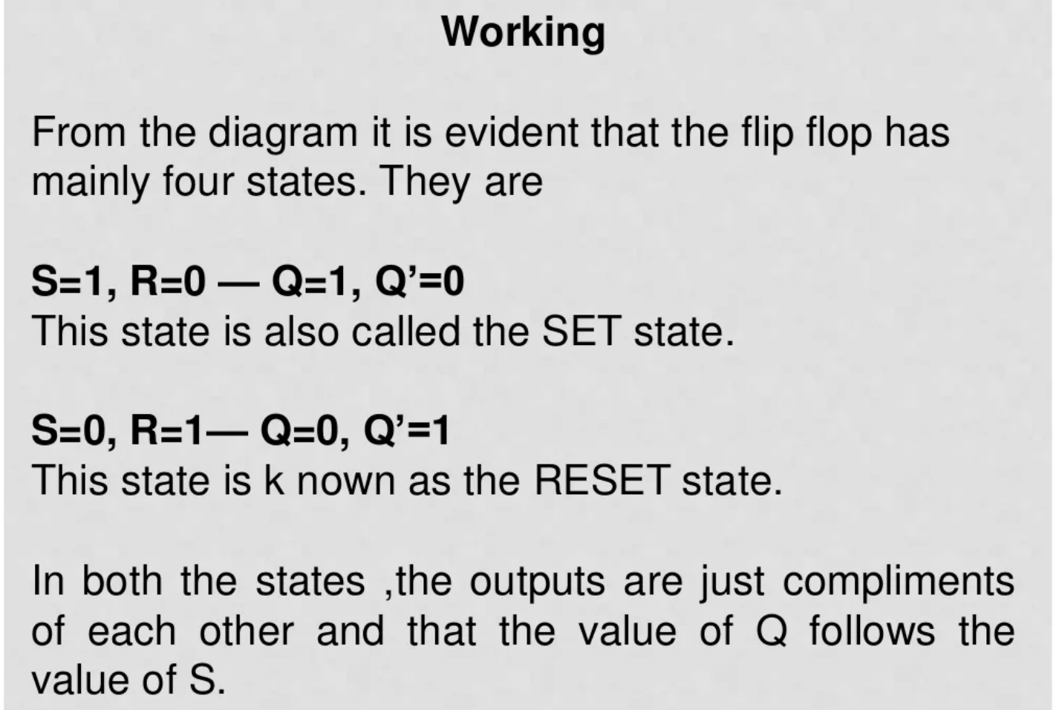
School of Computing Science & Engineering
Course Code : BEE01T1005 Course Name: Introduction to Digital System

Slide 11
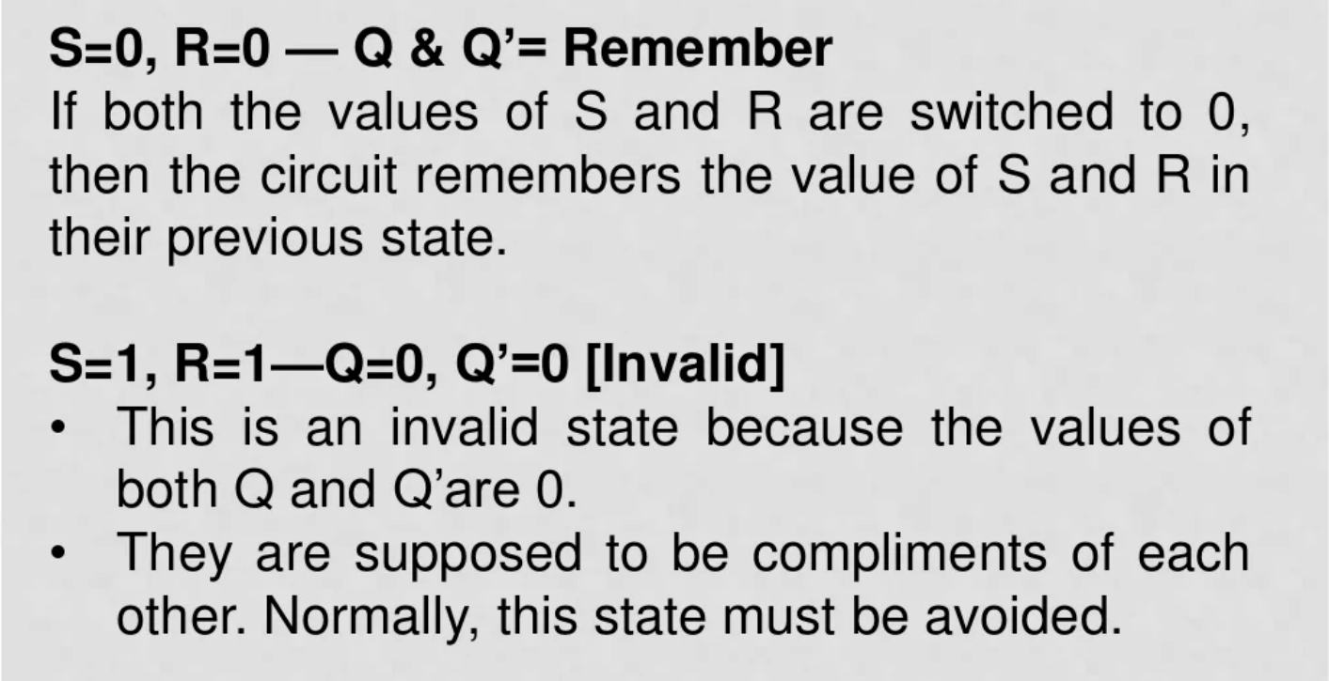
School of Computing Science & Engineering
Course Code : BEE01T1005 Course Name: Introduction to Digital System

Slide 12
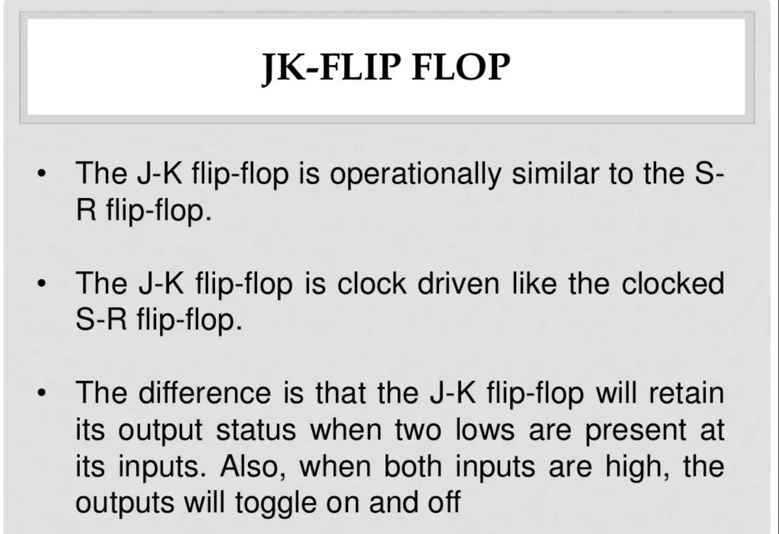
School of Computing Science & Engineering
Course Code : BEE01T1005 Course Name: Introduction to Digital System

Slide 13
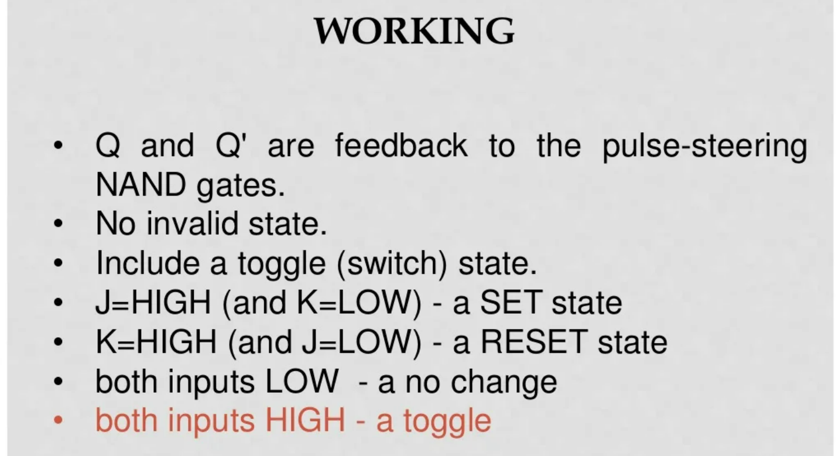
School of Computing Science & Engineering
Course Code : BEE01T1005 Course Name: Introduction to Digital System

Slide 14
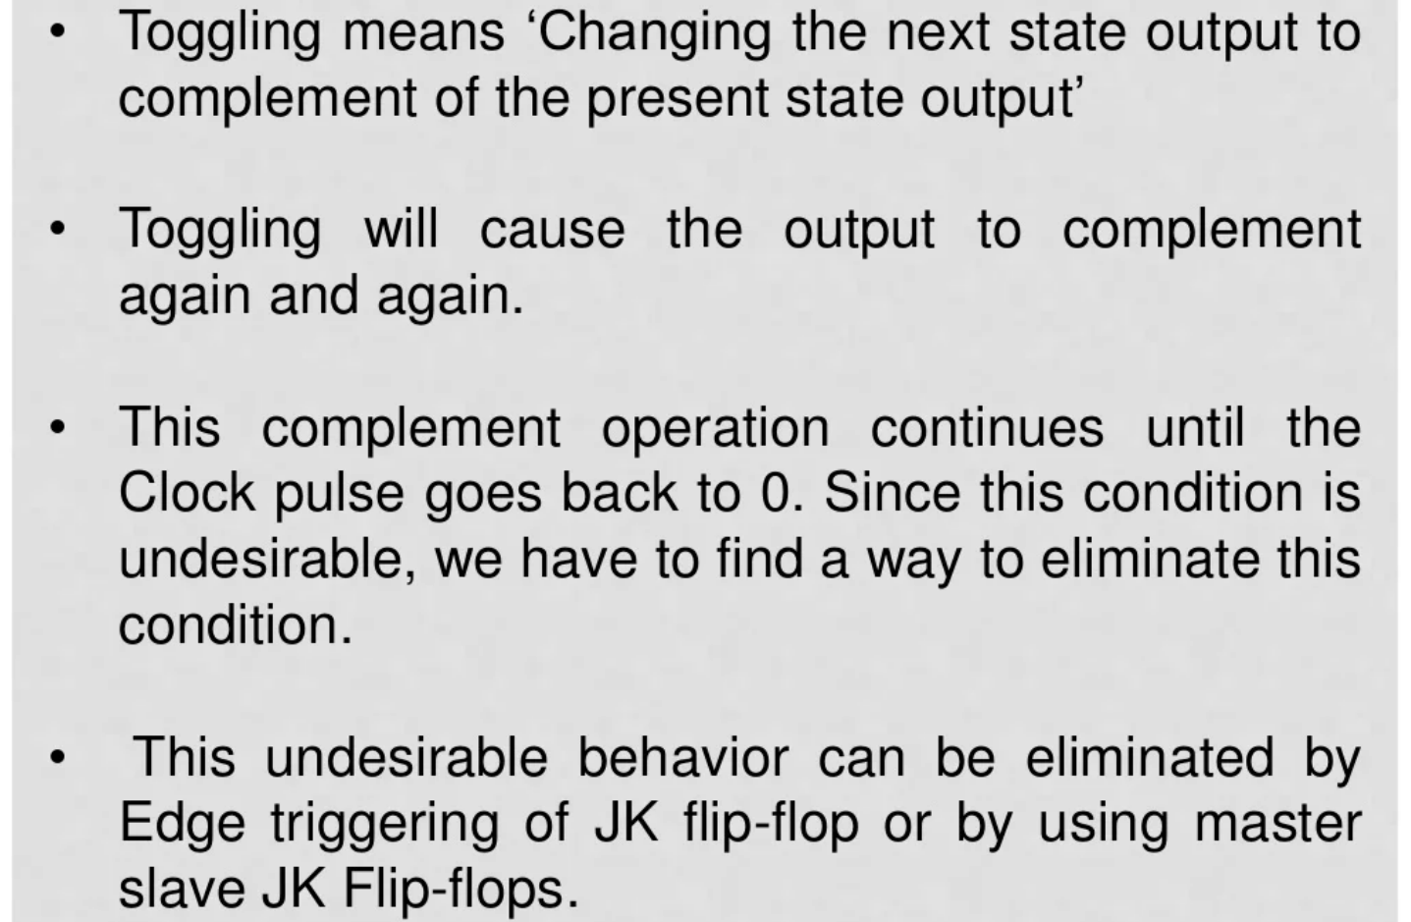
School of Computing Science & Engineering
Course Code : BEE01T1005 Course Name: Introduction to Digital System

Slide 15
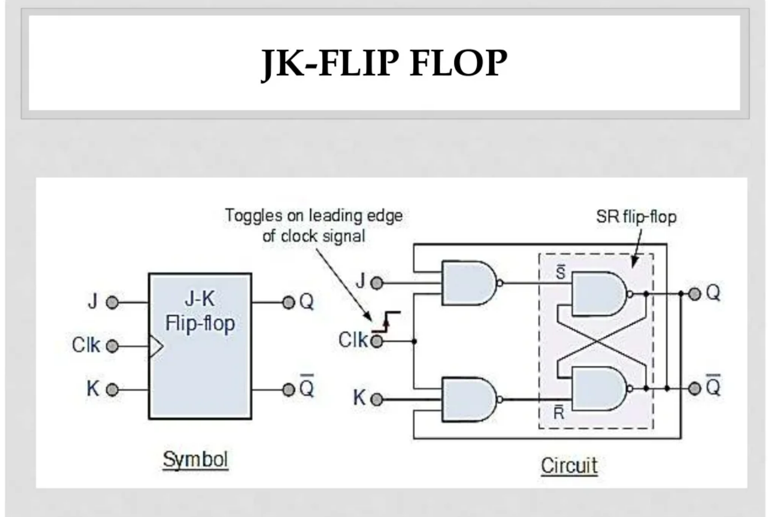
School of Computing Science & Engineering
Course Code : BEE01T1005 Course Name: Introduction to Digital System

Slide 16
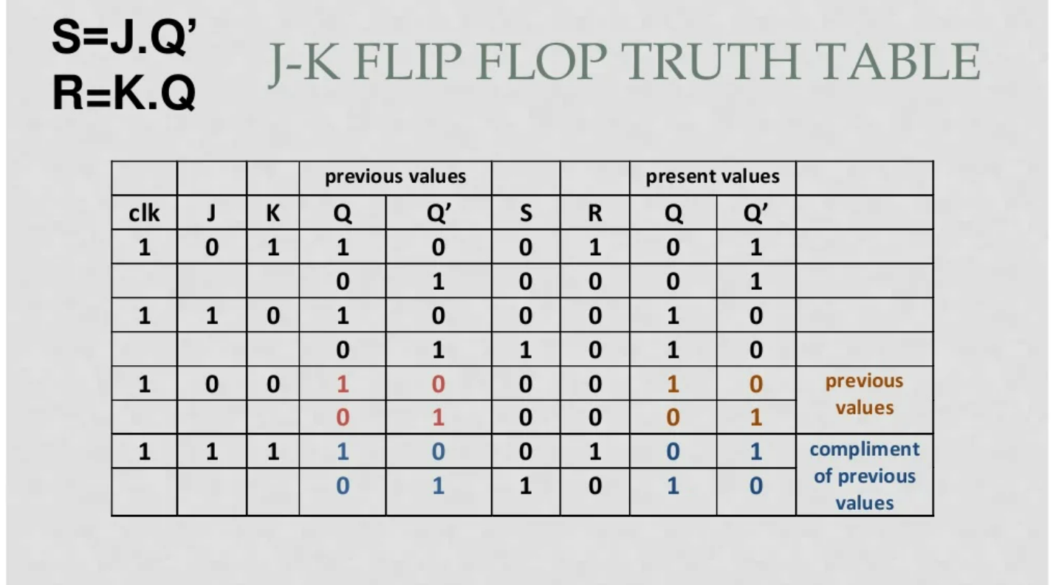
School of Computing Science & Engineering
Course Code : BEE01T1005 Course Name: Introduction to Digital System

Slide 17
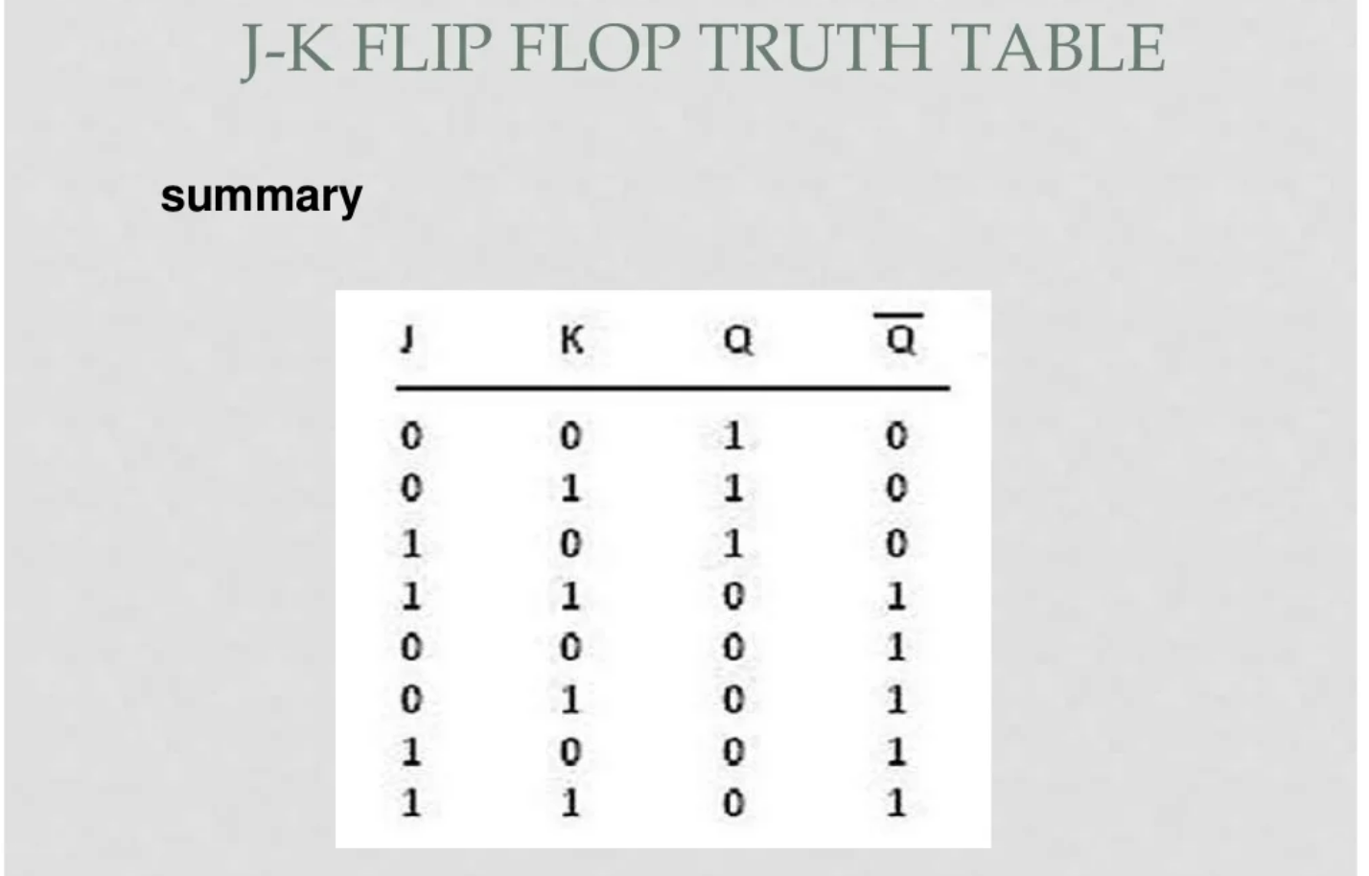
School of Computing Science & Engineering
Course Code : BEE01T1005 Course Name: Introduction to Digital System

Slide 18
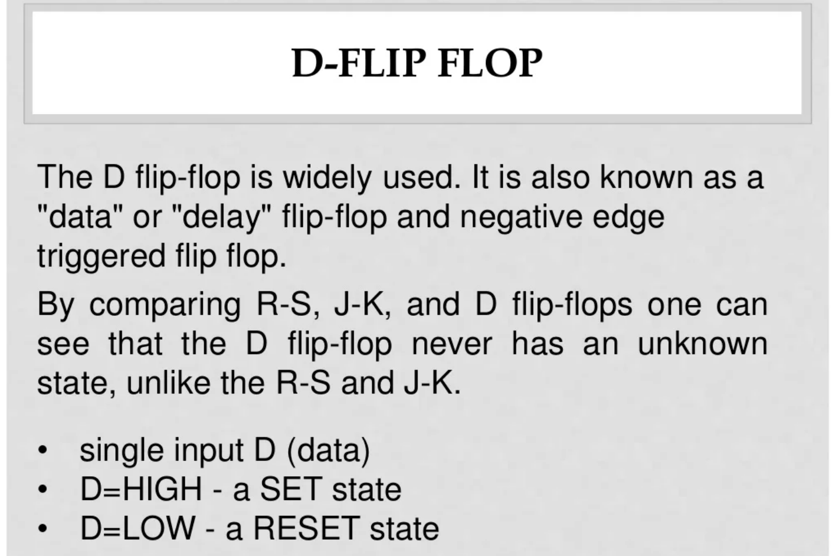
School of Computing Science & Engineering
Course Code : BEE01T1005 Course Name: Introduction to Digital System

Slide 19
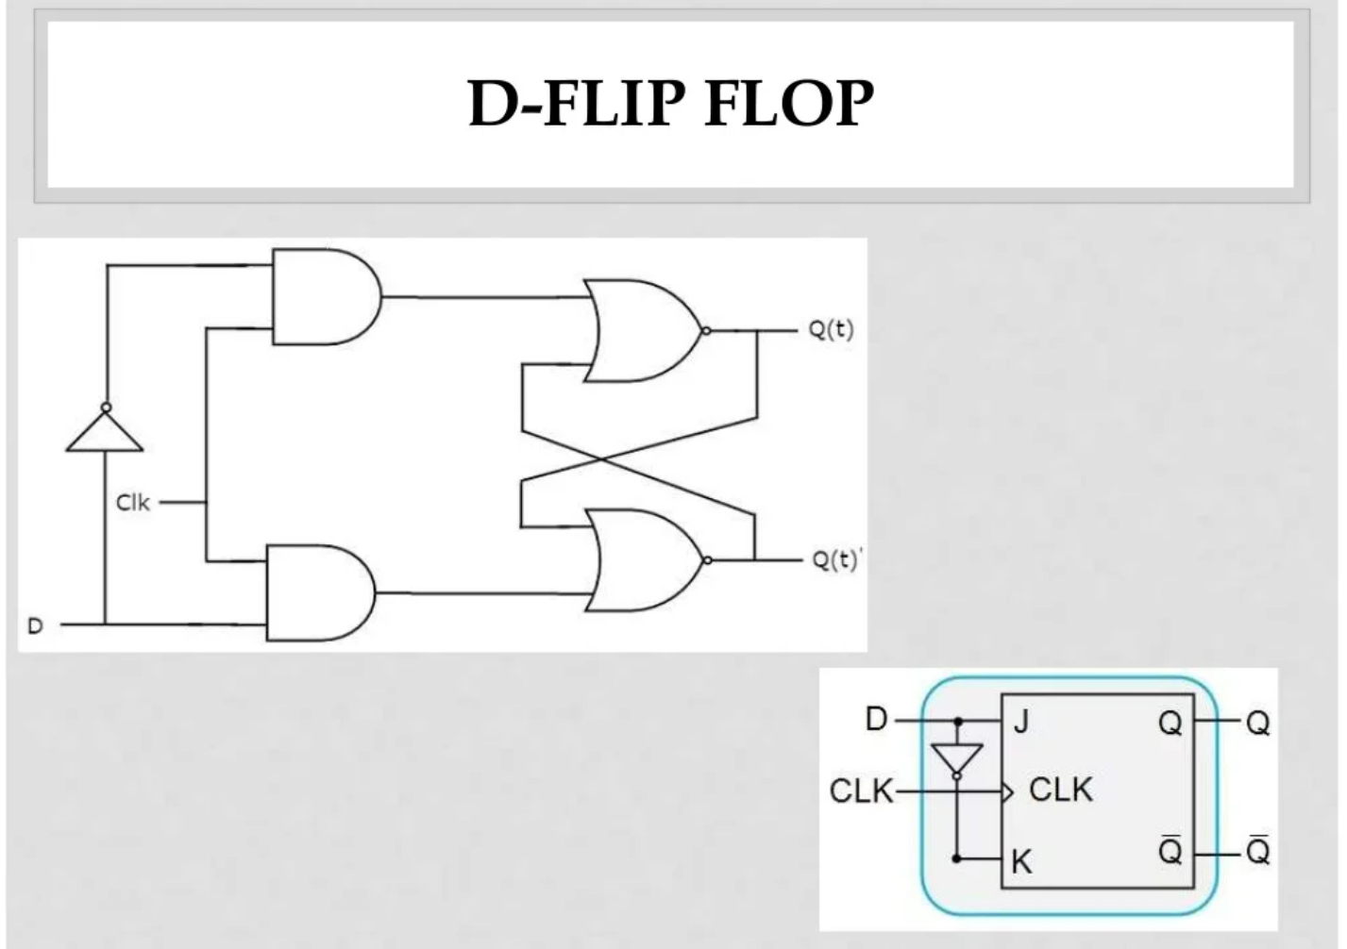
School of Computing Science & Engineering
Course Code : BEE01T1005 Course Name: Introduction to Digital System

Slide 20
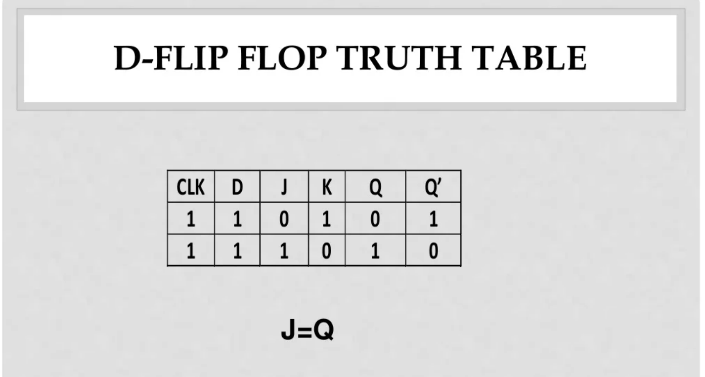
School of Computing Science & Engineering
Course Code : BEE01T1005 Course Name: Introduction to Digital System

Slide 21
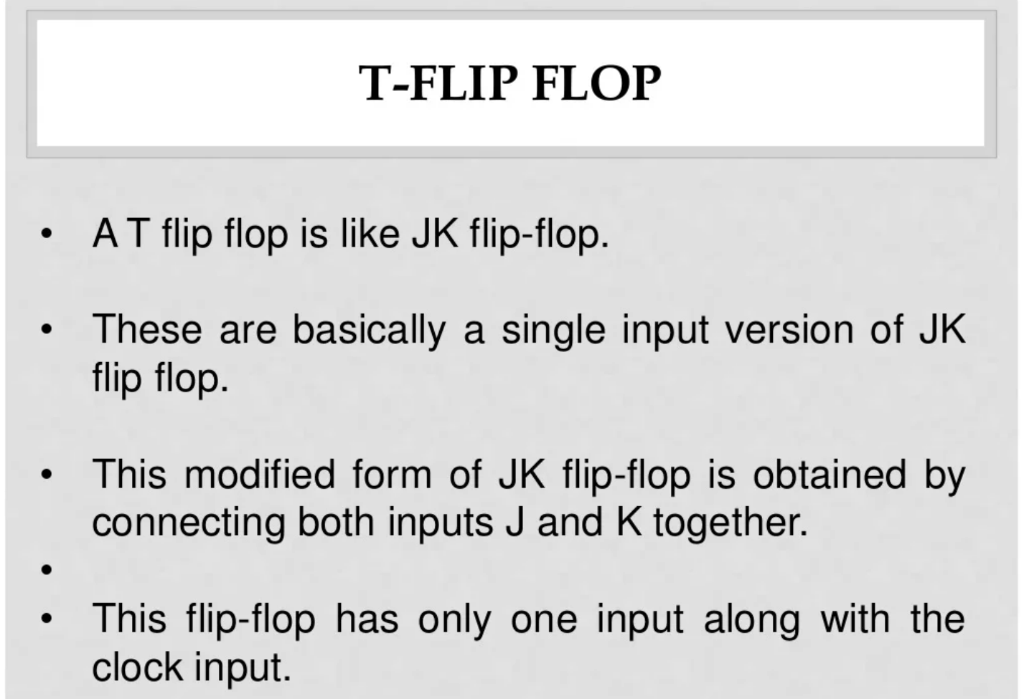
School of Computing Science & Engineering
Course Code : BEE01T1005 Course Name: Introduction to Digital System

Slide 22
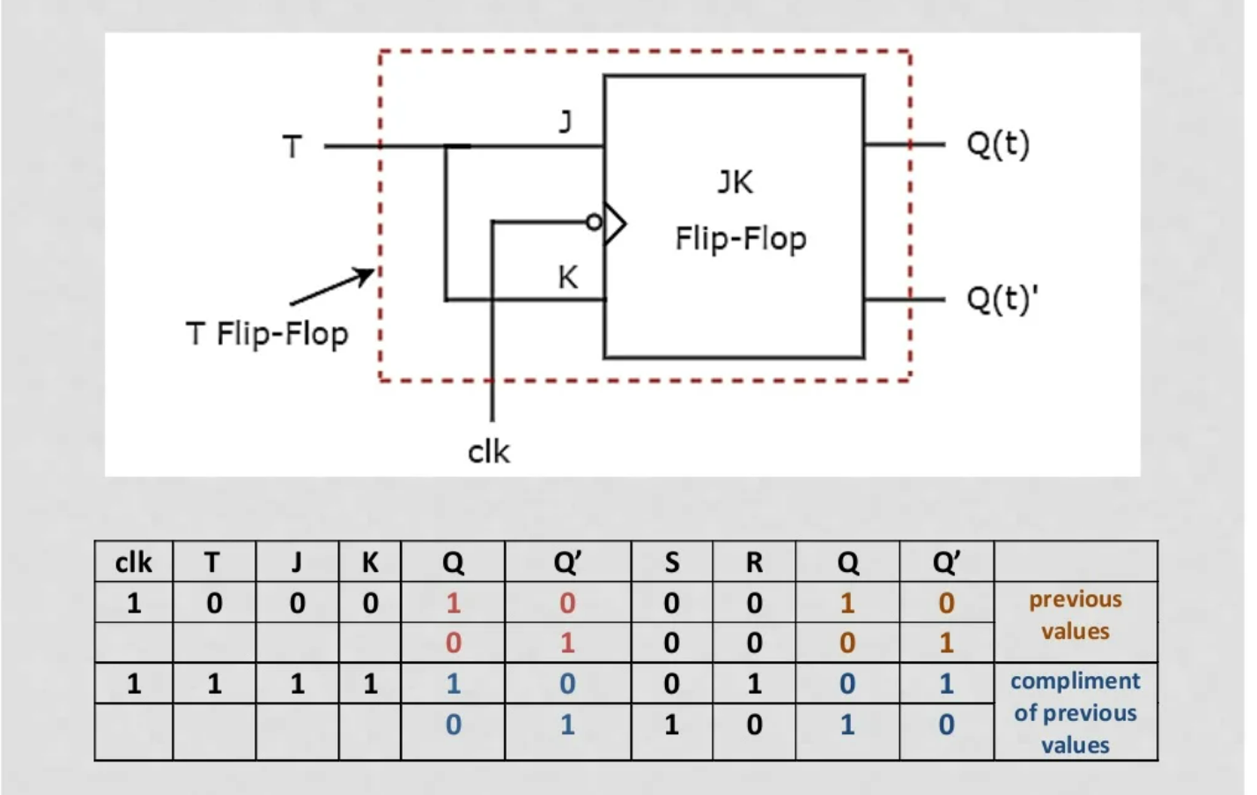
School of Computing Science & Engineering
Course Code : BEE01T1005 Course Name: Introduction to Digital System

Slide 23
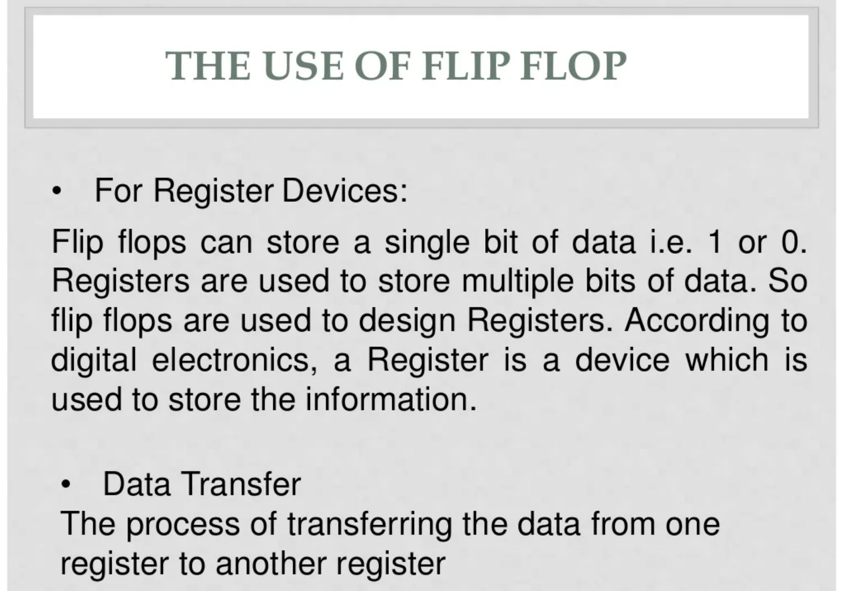
School of Computing Science & Engineering
Course Code : BEE01T1005 Course Name: Introduction to Digital System

Slide 24

School of Computing Science & Engineering
Course Code : BEE01T1005 Course Name: Introduction to Digital System

